Slide 1
BIKE SERVICE CENTRE MANAGEMENT SYSTEM
Avishek Laudary
Exam Roll No: 11403/20 T.U Registration No.:7-2-422-114-2020 Kist College of Management

Slide 2
Outlines
Introduction of Project
Introduction to Organization
Objectives
Proposed Statement
Conclusion

Slide 3
Introduction of Project
Bike Service Centre Management System provides proper management over the
website. In this system, Customer schedules their appointment online. Then the
customer selects their services as per their requirement.
With bike service centre management system, service centre owner can easily
schedule appointments, track client information, and further strengthen the
business by using the client’s data.
The aim of this website is to tackle the inefficiencies of manual record-keeping
and non-digitized operations in Nepal's bike service centres.

Slide 4
Introduction to Organization
Welcome to “The Bike Service Centre”, located in Neem Chowk, Damauli. Established with a commitment to excellence in bike care, we take pride in offering a range of services to keep your two-wheeler in prime condition.
From detail washing to essential engine oil changes, air filter replacements, brake oil enhancements, and various routine services, we cater to all aspects of your bike's well-being. As a well-running business, we prioritize our customers, ensuring they receive top-notch service with every visit. Our dedicated mechanics are committed to providing reliable and efficient solutions, making The Bike Service Centre your go-to destination for quality bike maintenance . Join us for a seamless experience where your satisfaction is our utmost priority.

Slide 5
Objectives
Accurate Record-Keeping
Optimize Resource Utilization
Promote Technological Modernization
Enhance Customer Communication
Data-Driven Decision-Making

Slide 6
PROPOSED SYSTEM
To tackle the inefficiencies of manual record-keeping and non-digitized operations in Nepal's bike service centres, the proposed solution is the implementation of the Bike Service Centre Management System (BSCMS). This digital platform introduces streamlined processes, including digital record-keeping, efficient appointment scheduling, automated customer interactions, and performance analytics. By embracing BSCMS, service centres can transition to a more modern and efficient operational model, eliminating errors associated with paper-based methods, reducing wait times, enhancing customer communication, and leveraging data-driven insights for continuous improvement. This solution not only addresses the current challenges but also propels bike service centres into a more competitive and technologically advanced era.
Incorporating modern technologies such as Java/PHP for backend
development, HTML, CSS, and JavaScript for frontend, and MySQL for
database management.

Slide 7
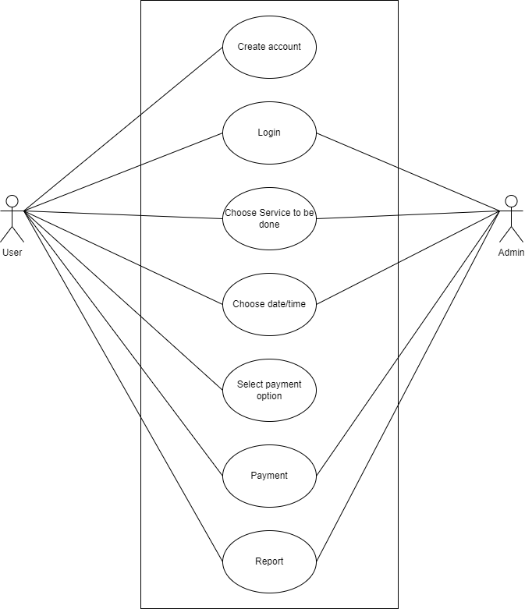
USE CASE DIAGRAM

Slide 8
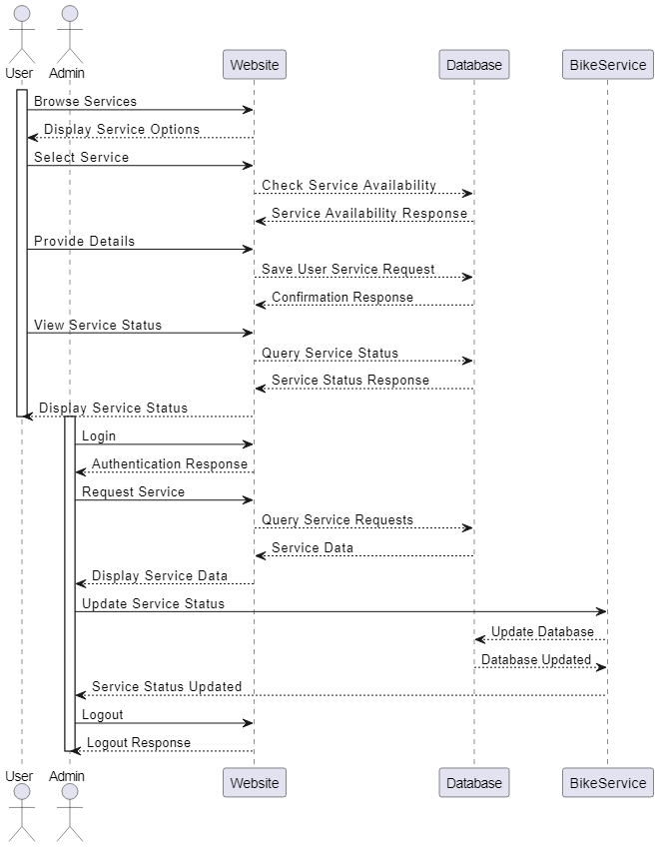
Sequence diagram

Slide 9
Conclusion
In conclusion, the Bike Service Centre Management System aims to be a pivotal tool for modernizing and optimizing the operations of our bike service centre. By addressing the challenges associated with bike washing and servicing management, we aspire to elevate the overall customer experience and establish ourselves as a leader in the industry.

